Slide 1

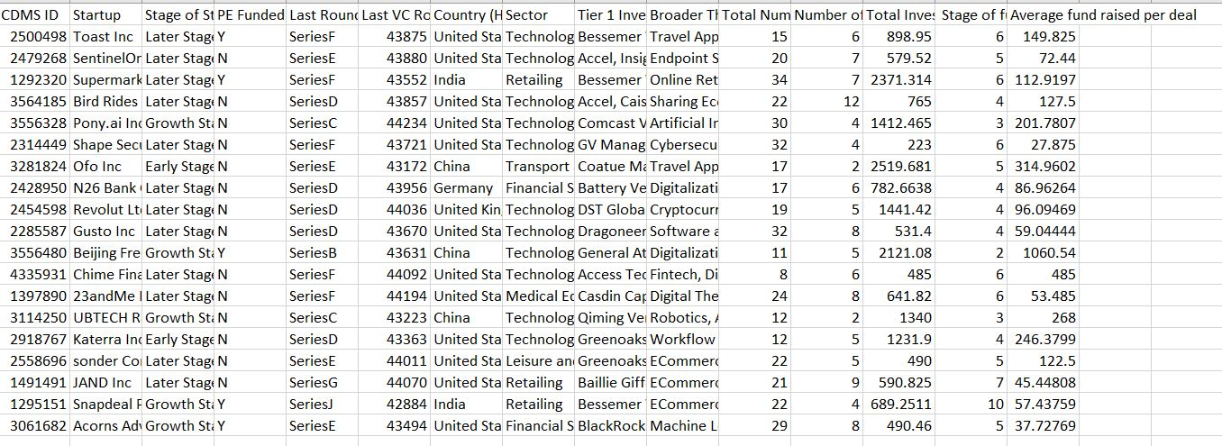
Sample Data

Slide 2
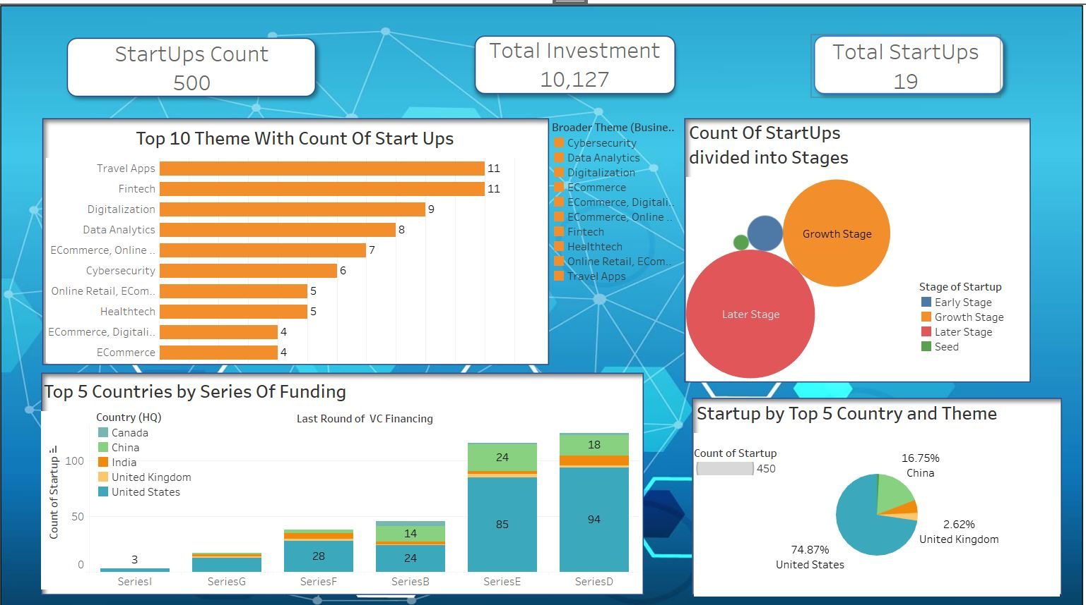
DashBoard

Slide 3
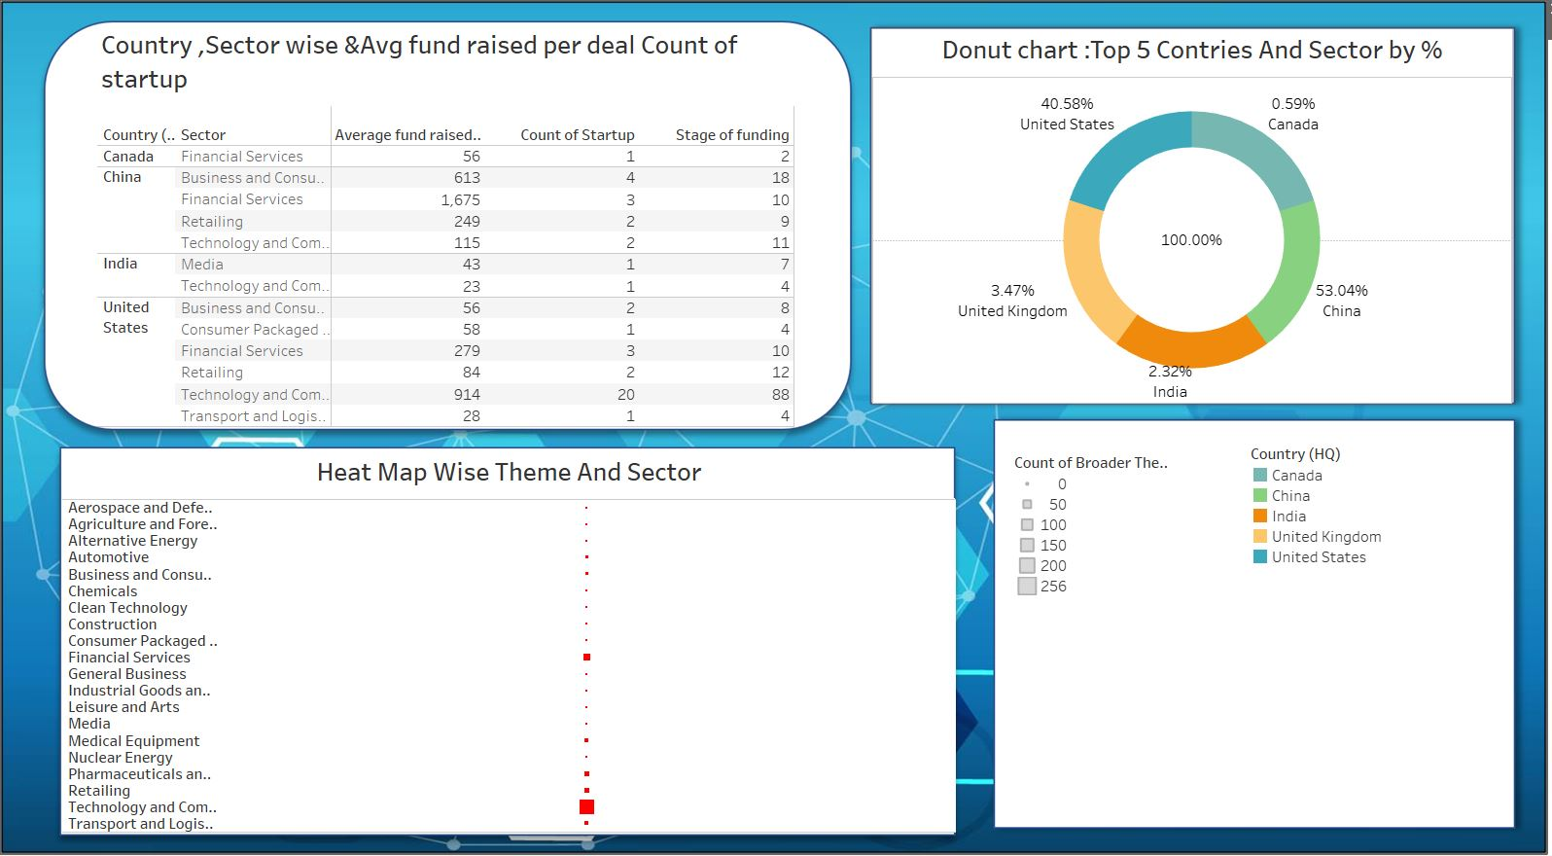

Slide 4

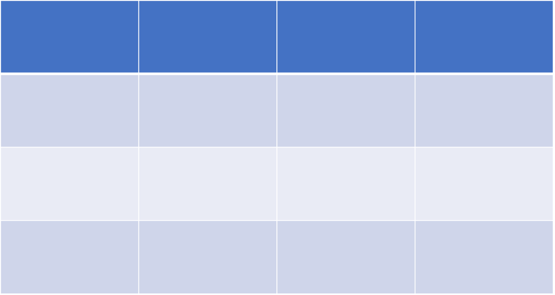
Estimation For This Project:
Sr.No | Estimation | Time | Cost Per Hour
1 | Data Cleaning | 3 Hour | 150*3=450
2 | Data Analysis | 2 Hour | 500*2=1000
3 | Dashboard Creation | 4 Hour | 700*4=2800

